Slide 1
#PSXiDiag
PowerShell ESXi Diagram
Mermaid-Markdown or -HTML-Report,
CSV-file for import to Draw.IO

Slide 2

Speaker Info
Martin Walther
Working with PowerShell
DevOps-/Systems Engineer Inventx AG
PowerShell Automator
VMware
ESXi/Linux
Windows
Blog
tinuwalther.github.io
https://github.com/tinuwalther
Social Media
Twitter: it_tinuwalther
Mastodon: tinuwalther@techhub.social
Owner of PsNetTools
Pode Web Apps
PSHTML-Reports
GitLab Pipelines
ESXi Host Deployments
vCenter Depolyments
VM Deployments
Operating as Code
everything I need

Slide 3
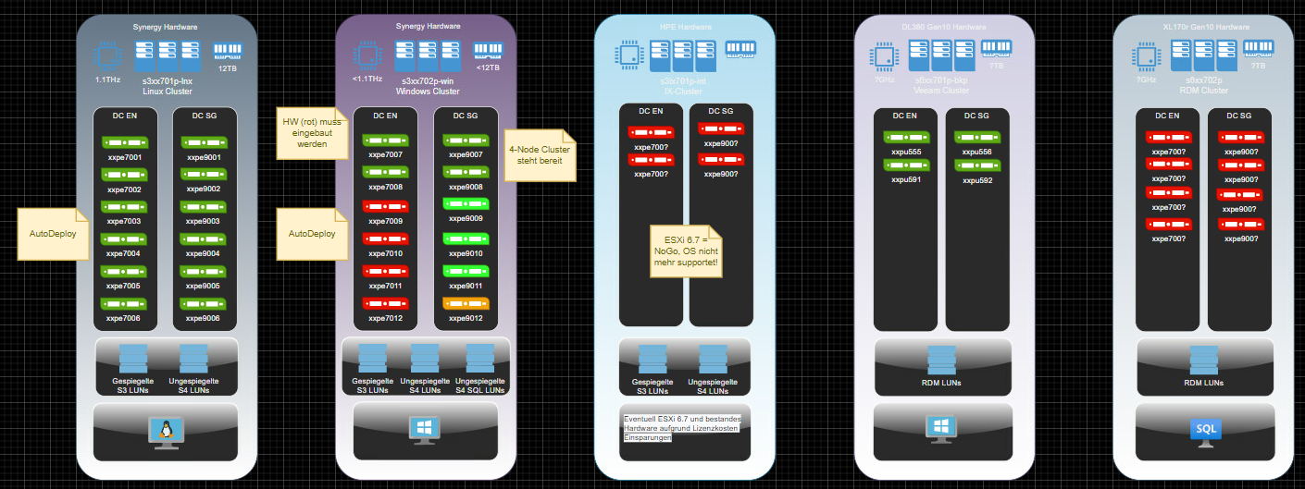
No #PSXiDiag
Everyone know this scenario
Your Boss ask you for the overview about the current VMware (or something else) environment.
You give him the last picture that you have created and he ask you »where are the 4 new ESXi hosts?«
shit... ☹
The last picture of the environment

Slide 4
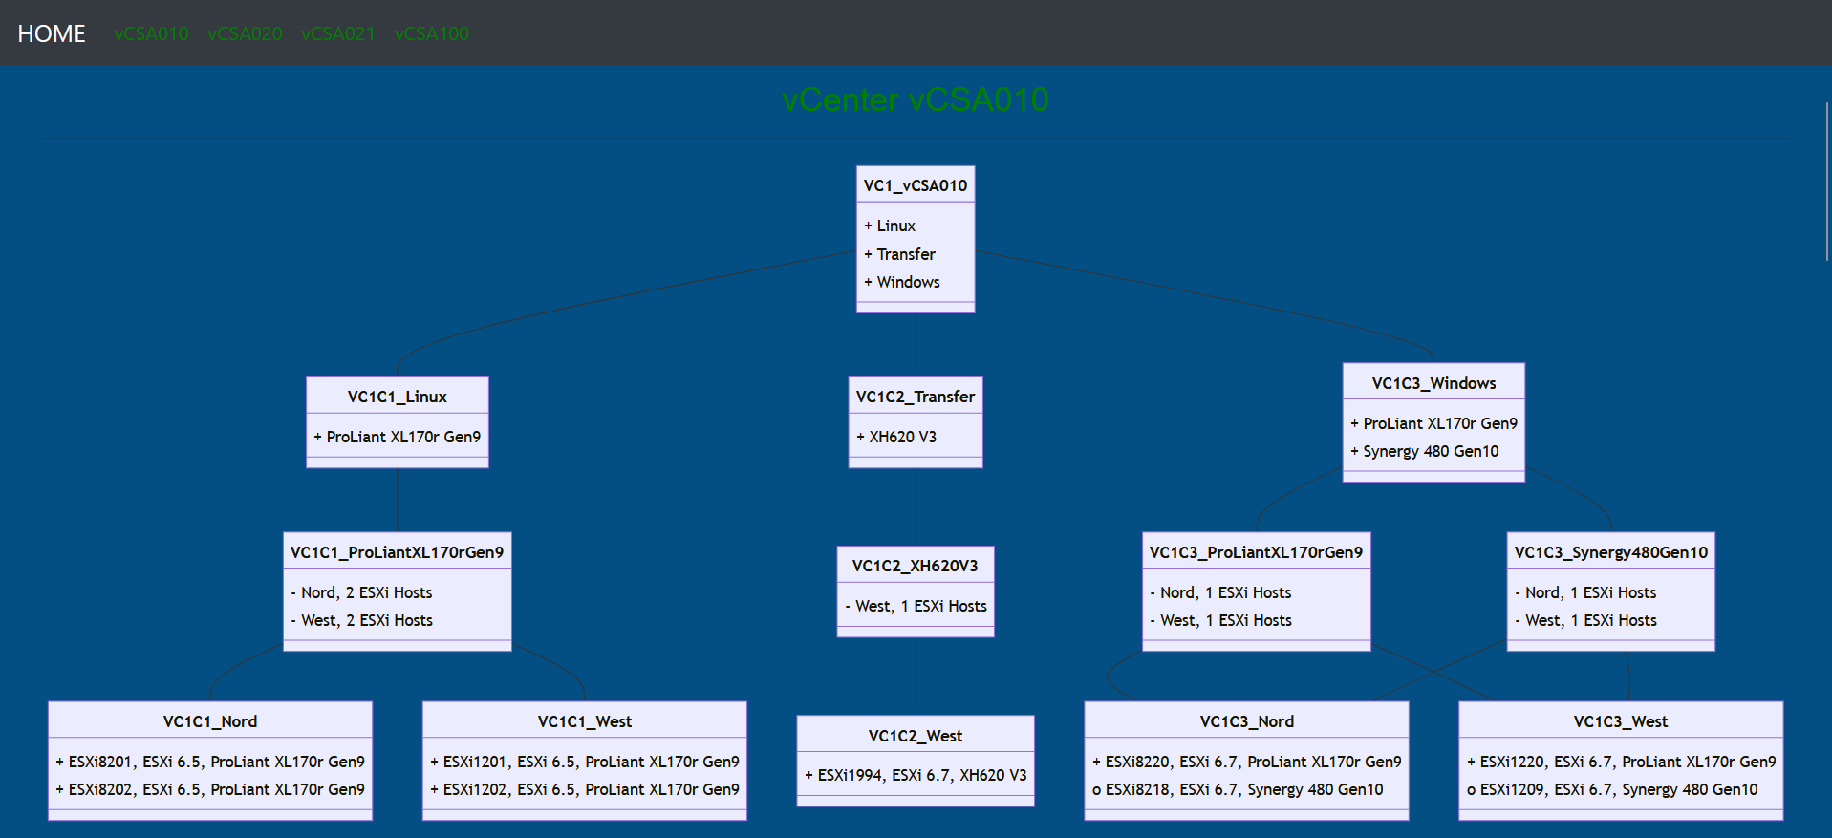
#PSXiDiag
You love this scenario
Your Boss ask you for the overview about the current VMware (or something else) environment.
You give him the link to the HTML-Report that #PSXiDiag create and he say »perfect, thank you!«
cool... ☺
HTML-Report of the environment

Slide 5
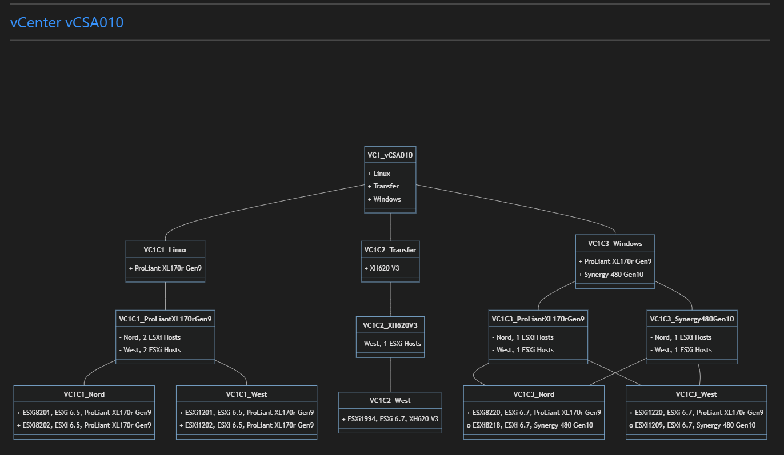
Markdown Mermaid Diagram
The simplest way to create a diagram
Output as Markdown
For Visual Studio Code

Slide 6
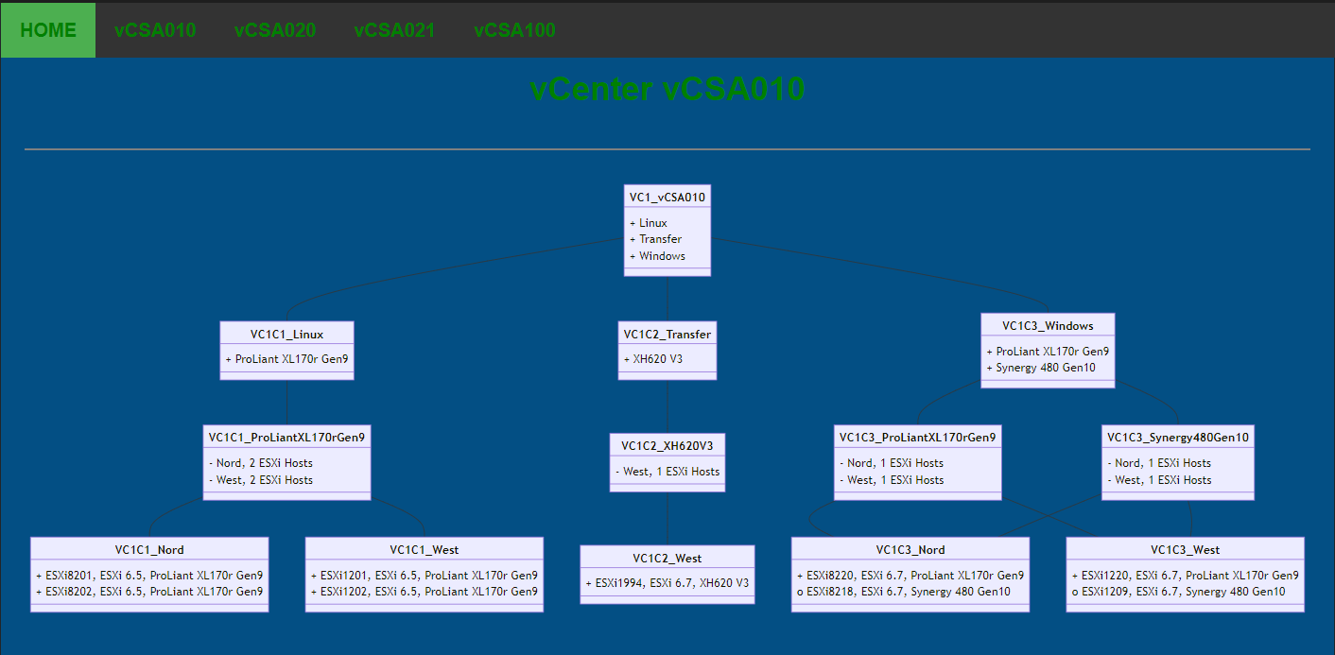
HTML Mermaid Diagram
HTML- and CSS Code inside the HTML-file
Access to mermaid.mim.js needed
Send file as Email

Slide 7
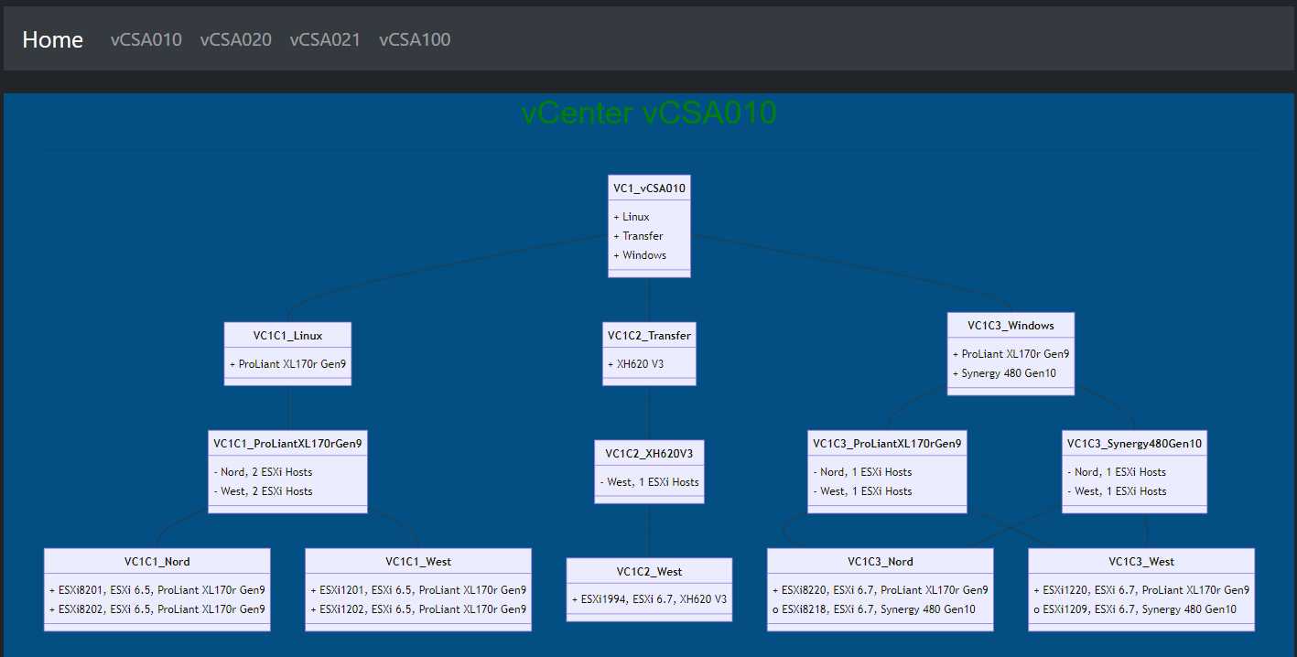
PSHTML Mermaid Diagram
All libraries are included in the project in the assets-folder
No access to the Internet is needed
For Pode- or other web server

Slide 8
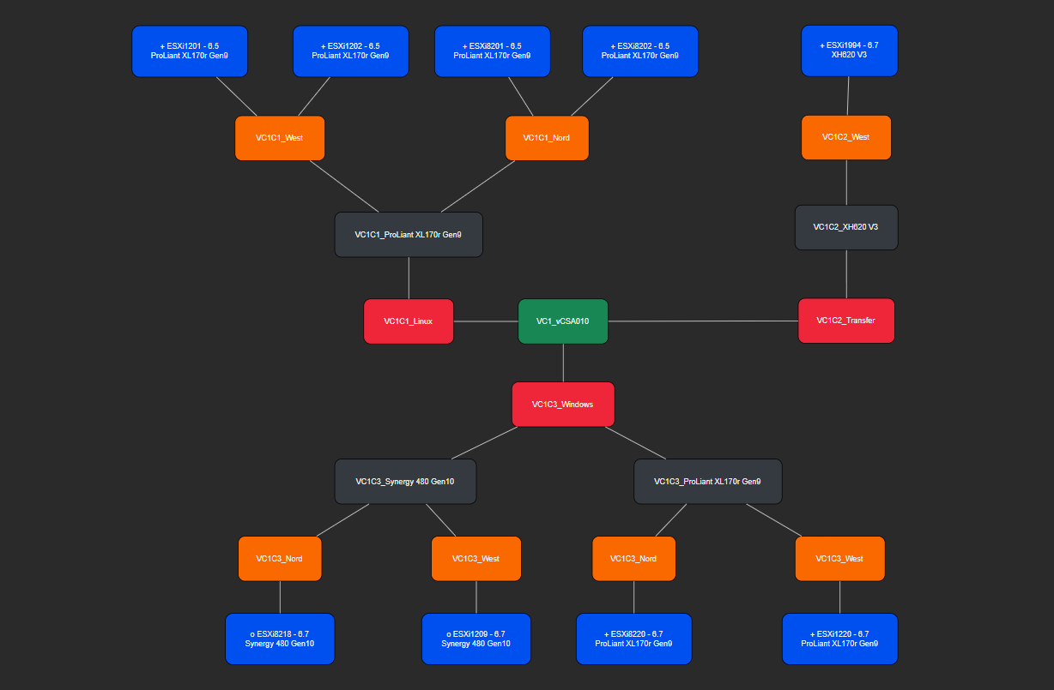
CSV-file for Draw.IO
CSV-files can be imported in to Draw.IO
Flexible adaptable in Draw.IO

Slide 9
Demo

